Slide 1
Capstone The Battle of the Neighborhoods
Opening a wine bar around manhattan

Slide 2
Introduction
Saving accounts have very low interest rate. Thus, I want to invest a portion of my savings into a commercial business to generate higher income.
My passion is Wine tasting and living in New York → the goal is to find the most suitable neighborhood in New York to open a successful Wine Bar.
CRITERIA
The Wine Bar will be around Manhattan.
The Wine Bar will be nearby other restaurants. Perfect for a glass of wine after work and before dinner.
The Wine Bar will be located in a neighborhood with other similar wine bars. If they are operating it probably means that it is the right area to open a new one.

Slide 3
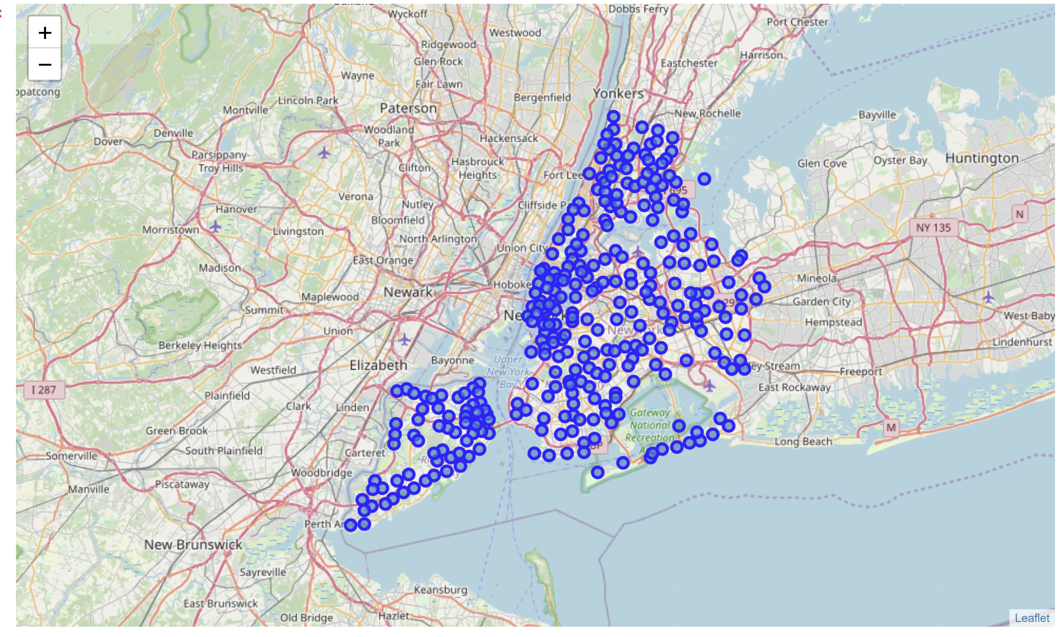
Map of the new York area

Slide 4
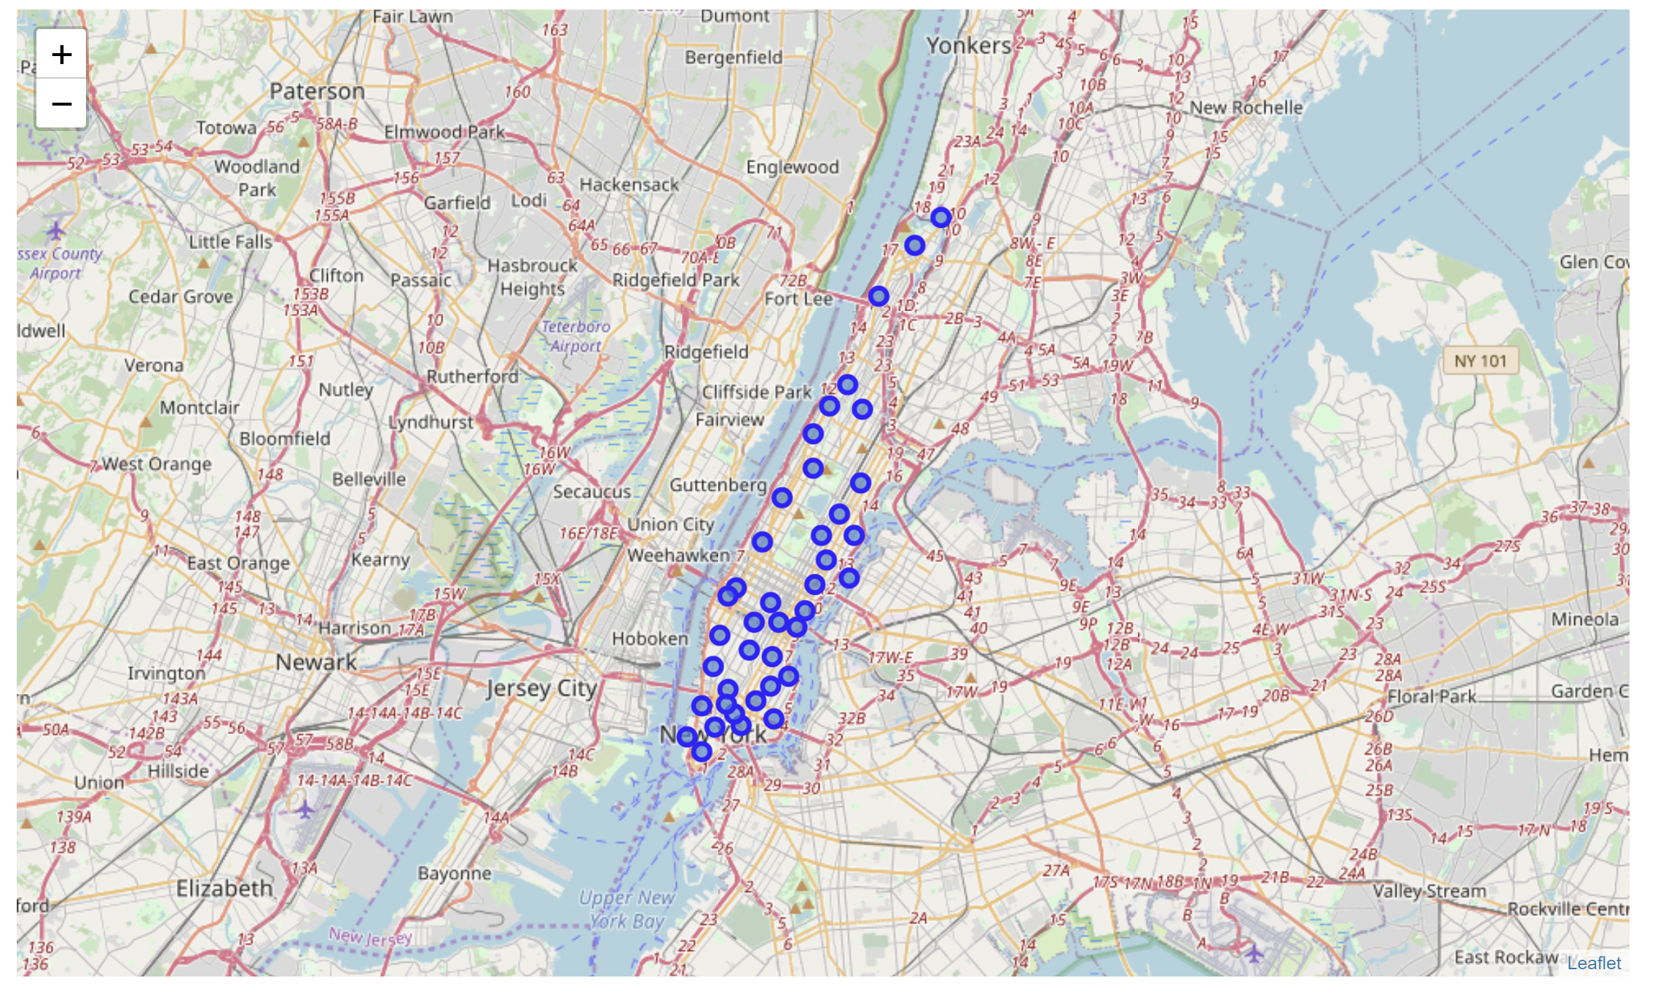
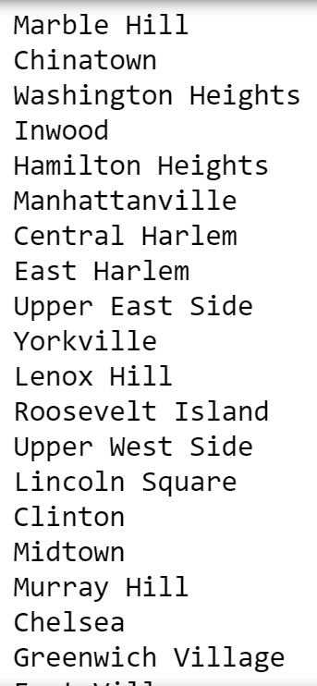
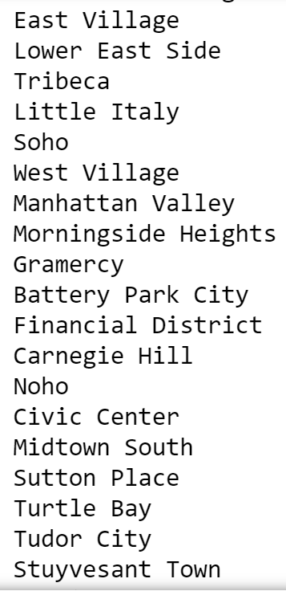
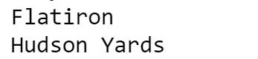
Manhattan neighborhoods

Slide 5
data
The json file of New York can be downloaded from: https://cocl.us/new_york_dataset/newyork_data.json
Neighborhood has a total of 5 boroughs and 306 neighborhoods. In order to segement the neighborhoods and explore them, we will essentially need a dataset that contains the 5 boroughs and the neighborhoods that exist in each borough as well as the the latitude and logitude coordinates of each neighborhood.
Data about venues obtained from Foursquare https://developer.foursquare.com/places

Slide 6
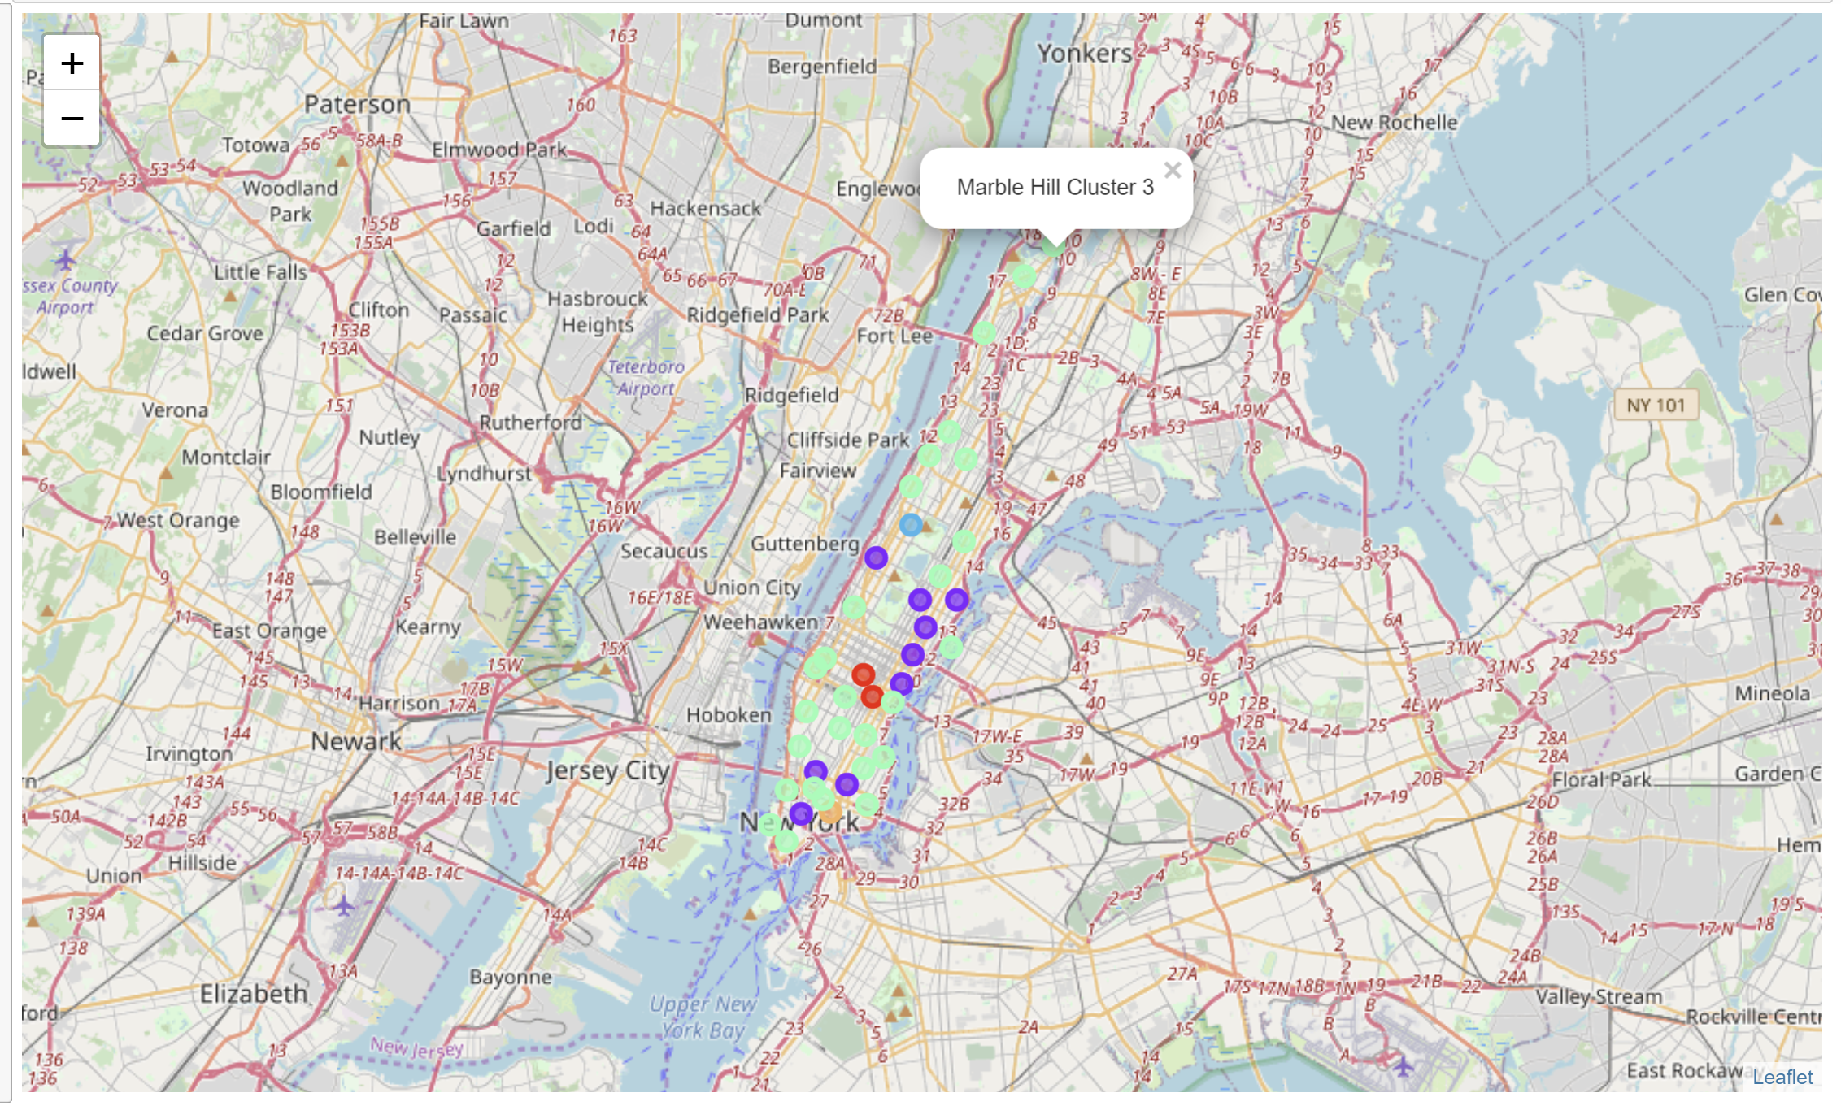
clustering

Slide 7
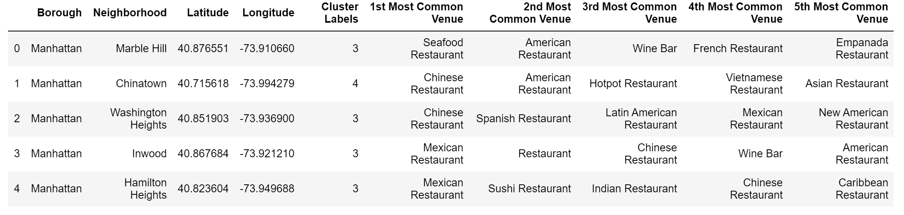
Clustering details

Slide 8
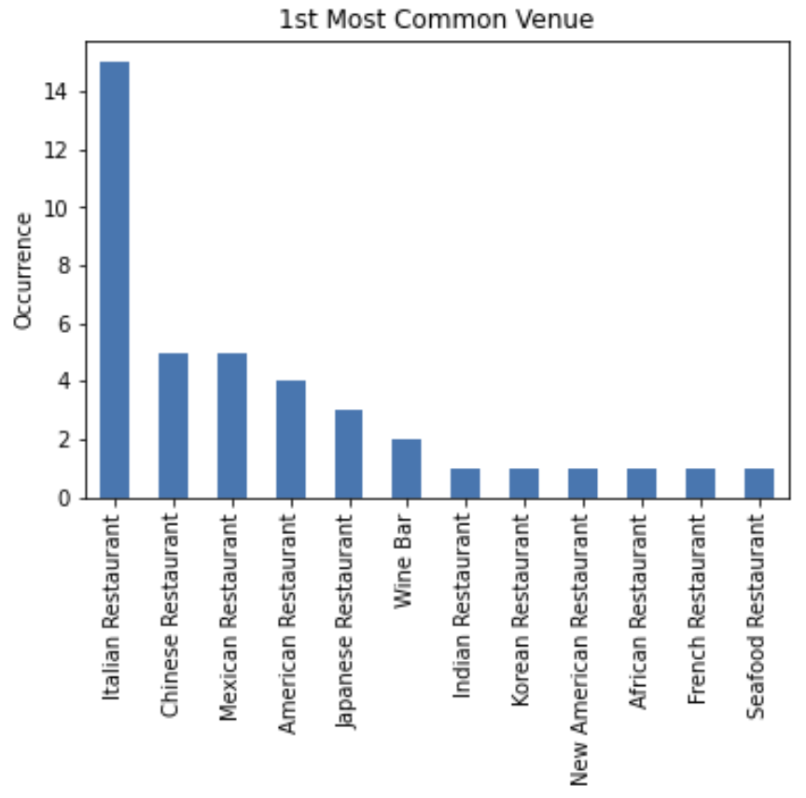
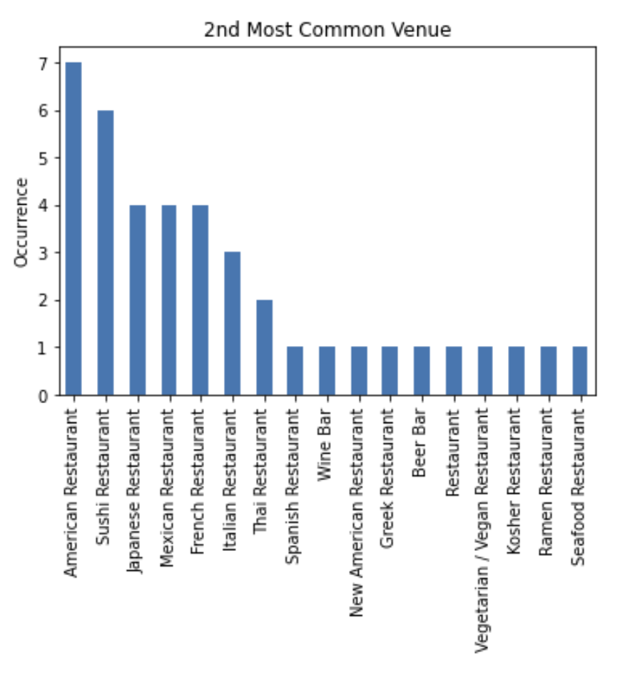
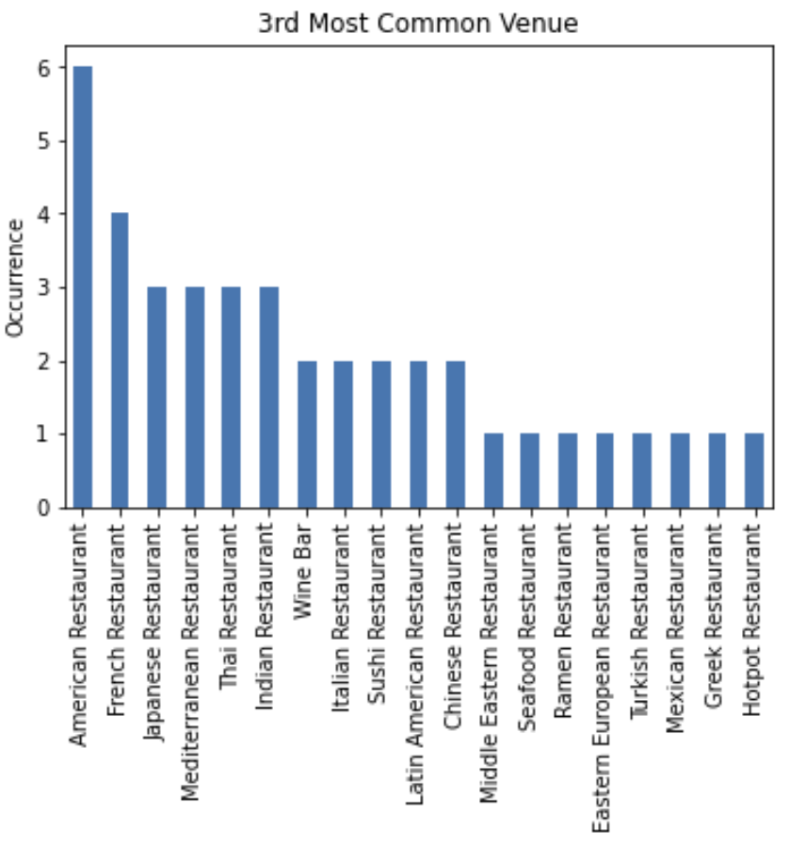
Results by most common venues

Slide 9
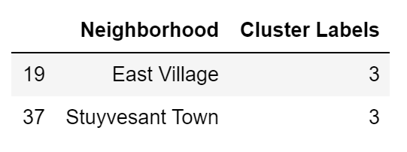
Results by neighborhoods
The neighborhoods with Wine Bar as the 1st Most Common Venues are

Slide 10
Conclusions
The aim of this project is to find the best neighborhood around Manhattan to open a new Wine Bar as investment.
We analyzed the neighborhoods of Manhattan and we listed the venues in each area.
We clustered the areas, and we found the best area to open a Wine Bar based on similar features.

